Slide 2
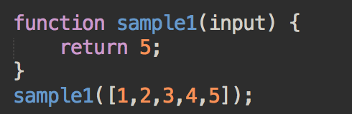
Discussion
Let’s discuss what the following snippet does, and its efficiency.

Slide 3
Discussion
Let’s discuss what the following snippet does, and its efficiency.
>> What happens if your input size increases from ‘5’ to ‘1000000000’?

Slide 4
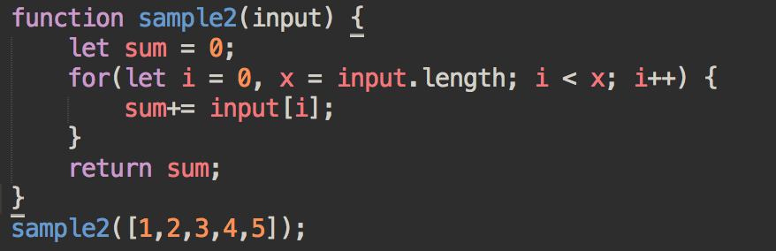
Discussion
Let’s discuss what the following snippet does, and its efficiency.

Slide 5
Discussion
Let’s discuss what the following snippet does, and its efficiency.
>> What happens if your input size increases from ‘5’ to ‘1000000000’?

Slide 6
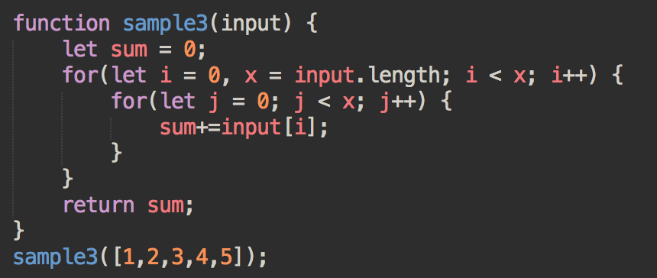
Discussion
Let’s discuss what the following snippet does, and its efficiency.

Slide 7
Discussion
Let’s discuss what the following snippet does, and its efficiency.
>> What happens if your input size increases from ‘5’ to ‘1000000000’?

Slide 8
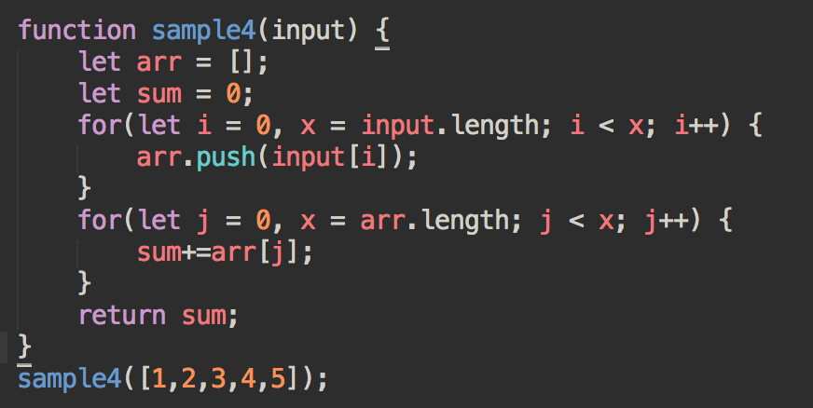
Discussion
Let’s discuss what the following snippet does, and its efficiency.

Slide 9
Discussion
Let’s discuss what the following snippet does, and its efficiency.
>> What happens if your input size increases from ‘5’ to ‘1000000000’?

Slide 10
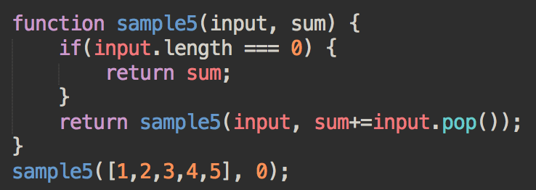
Discussion
Let’s discuss what the following snippet does, and its efficiency.

Slide 11
Discussion
Let’s discuss what the following snippet does, and its efficiency.
>> What happens if your input size increases from ‘5’ to ‘1000000000’?

Slide 12
Big O Notation
Big O notation is used to describe worst-case runtime and evaluates how your function performance changes with varying input size.

Slide 13
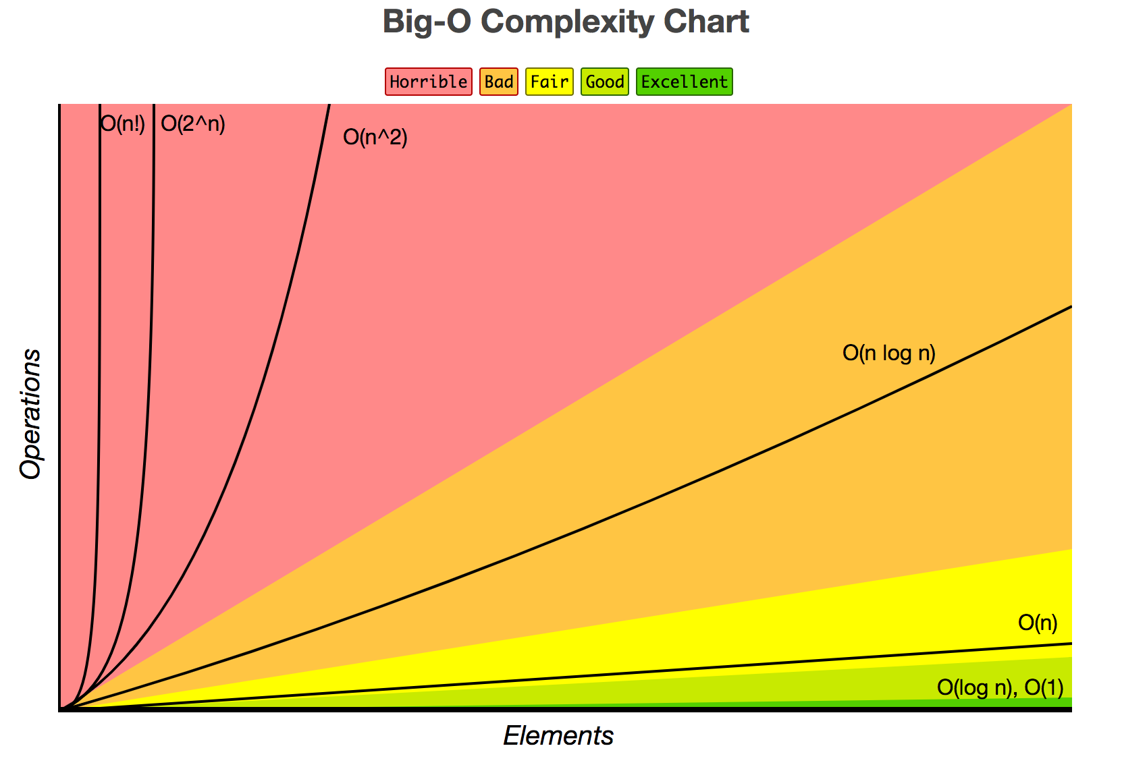
Taken from: http://bigocheatsheet.com/

Slide 14
Review Questions
What is the Big O notation for inserting an item at the beginning of an array?
What is the Big O notation for deleting an item at the beginning of an array?
What is the Big O notation for checking if an item is in an array?

Slide 15
Review Questions
What is the Big O notation for inserting an item at the beginning of an array? => O(n)
What is the Big O notation for deleting an item at the beginning of an array?
What is the Big O notation for seeing if an item is in an array?

Slide 16
Review Questions
What is the Big O notation for inserting an item at the beginning of an array? => O(n)
What is the Big O notation for deleting an item at the beginning of an array? => O(n)
What is the Big O notation for seeing if an item is in an array?

Slide 17
Review Questions
What is the worst case runtime complexity for inserting an item at the beginning of an array? => O(n)
What is the worst case runtime complexity for deleting an item at the beginning of an array? => O(n)
What is the worst case runtime complexity seeing if an item is in an array? => O(n)

Slide 18
Review Questions
What is the worst case runtime complexity for accessing an item in an array given the index?
Is an O(1) function faster than an O(n) function?

Slide 19
Review Questions
What is the worst case runtime complexity for accessing an item in an array given the index? => O(1)
Is an O(1) function faster than an O(n) function?

Slide 20
Let’s search for stuff
Given a SORTED array of numbers, find a target number (if it exists).
Input: ( [0, 1, 2, 3, 4, …, 99, 100], 2)
Output: 2
Input: ( [0, 1, 2, 3, 4, …, 99, 100], 88)
Output: 88
Input: ( [0, 1, 2, 3, 4, …, 99, 100], 200)
Output: -1

Slide 21
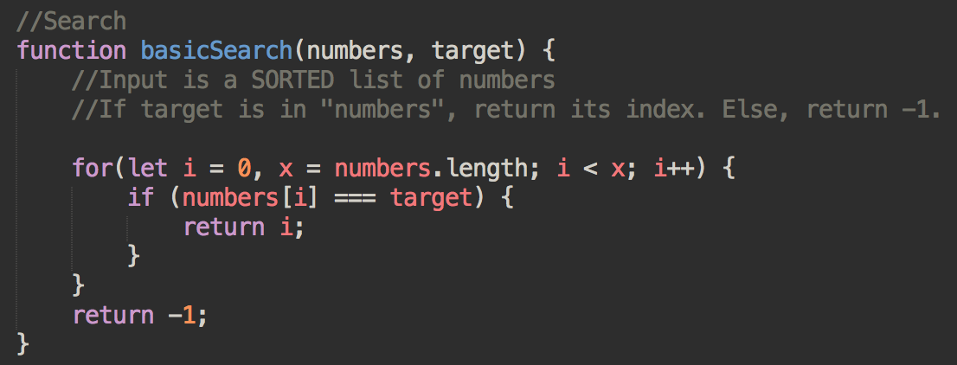
Let’s search for stuff
Runtime: O(?)
Space: O(?)

Slide 22
Let’s search for stuff
Runtime: O(n)
Space: O(1)

Slide 23
How can we improve this?

Slide 24
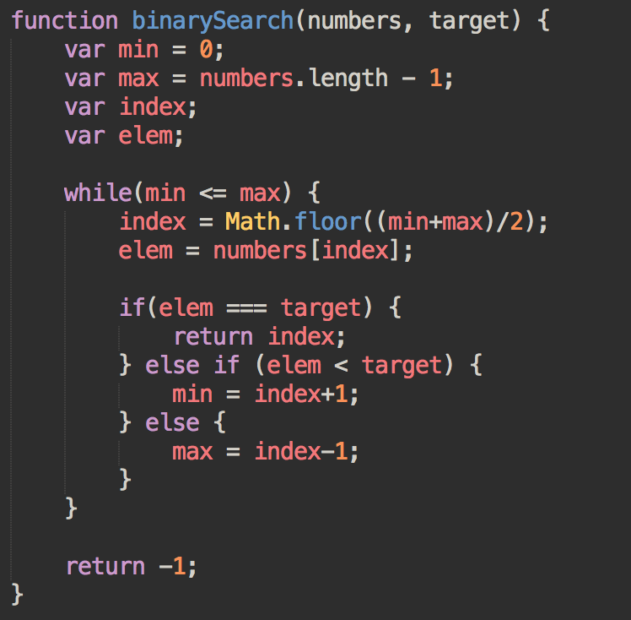
Let’s search for stuff (better)
Runtime: O(?)
Space: O(?)

Slide 25
Uno mas
Given an array of strings, return a duplicate entry if one exists. If there are none, return -1.
Input: ( [“A”, “B”, “C”, “D”, “A”])
Output: A
Input: ([“A”, “B”, “C”, “D”])
Output: -1

Slide 26
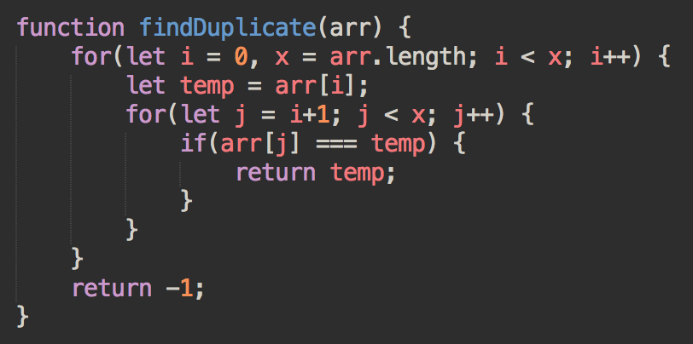
Find Duplicate
Runtime: O(?)
Space: O(?)

Slide 27
Find Duplicate
Runtime: O(n^2)
Space: O(1)
Why is it n^2? Can we improve this? If so, to what? And how?

Slide 28
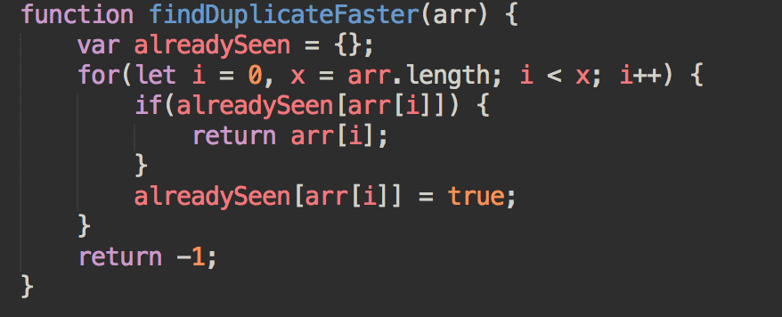
Find Duplicate
Runtime: O(n)
Space: O(n)

Slide 29
Resources
http://vlsicad.ucsd.edu/courses/cse21-s14/exercises/bigO-practicesol.pdf
http://web.mit.edu/16.070/www/lecture/big_o.pdf

